Slide 1

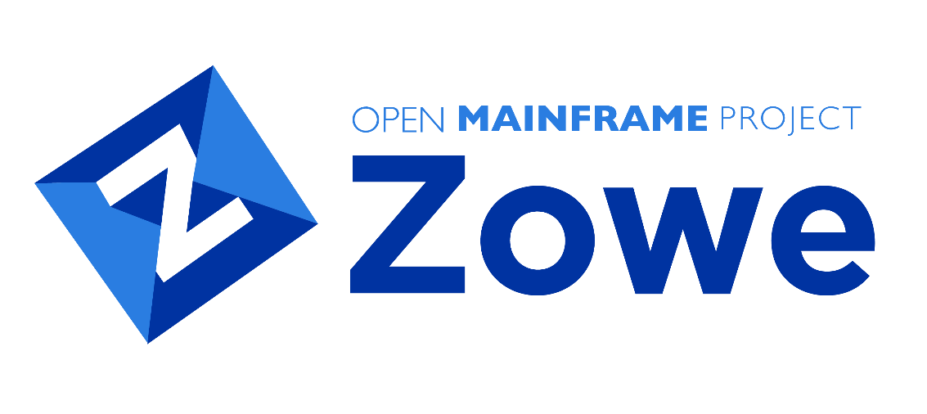
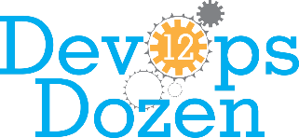
Best DevOps for Mainframe Solution
Notes:
Fantastic news if you haven’t heard: Zowe won this year’s DevOps Dozen award for Best DevOps for Mainframe solution, hosted by DevOps.com
This recognition is particularly noteworthy because Zowe was selected over a number of well-established, well-known commercial offerings. Chalk one up for the next-generation! And check out the “Top 5 Reasons to be Excited About Zowe” article on the Zowe Medium site: medium.com/zowe (https://medium.com/zowe/top-5-reasons-to-be-excited-about-zowe-5de9c83d7554)
[more detail] Zowe’s win reflects the advantages of community in solving seemingly intractable problems. In this case, how could mainframe teams realize the value of DevOps and modernization without compromising the platform’s core benefits/attributes: reliability, scalability, and security? A challenge too great for any single vendor, Broadcom, IBM and Rocket Software joined together with the Linux Foundation’s Open Mainframe Project to introduce the Zowe framework in 2018. Since then, the framework has expanded, the ecosystem had grown and adoption has flourished — it is proving to be a real game-changer.

